Slide 1

Buckingham Village HOMEOWNERS’ Association
2024 Annual Meeting

Slide 2
Mission Statement
“To maintain the beauty and services of our community with integrity and transparency.”

Slide 3
General Meeting Conduct
We would appreciate for everyone to adhere to one conversation and allow the other party to finish speaking. We also ask that you be respectful and keep the conversation constructive.

Slide 4
Board Members
President – Renay DeLuca
Treasurer – Rachel Rost
Secretary – Karen Kruszka
General Member – Michelle Folden
General Member – Michelle Efthemiou

Slide 5
Agenda
Improvement Updates
Future Projects
General Information
Financials
Dues
Questions/Comments

Slide 6
Improvement Updates
Landscaping complete on SE corner of Heydenreich & Gloria
Treatment of diseased trees along Heydenreich
Dead trees taken down and one fallen from storms removed
Sprinkler Repairs
  lines/heads repaired
Dues Collections/Legal Actions
  Still working with lawyer to collect from 6 households

Slide 7
Future Projects
Overhaul of landscaping along areas on 23 mile and in front of signs
    Repairs to sprinkler and electrical lines
    Could run into fall or 2025 depending on timeline of repairs
Replacement of trees removed in late 2023
Sidewalk repairs to asphalt on both sides of Heydenreich
Petition to Township Board to add lights to BV1 sub
  Would be completed by the township and paid overtime by residents if approved

Slide 8

General Information
Standard Mailboxes
  If your current mailbox needs to be replaced, you must replace it with the standard mailbox for our sub
  A link and further details can be found on our website in the ‘INFO’ section
Household Improvements
  Any improvements to the outside of your home need to be approved by the board
  An Architectural Request Form must be filled out (in the INFO section of our website)
  and submitted to the HOA email with the necessary documents prior to beginning the work
Annual Sub Sale
  June 20-22nd (Thursday-Saturday)

Slide 9
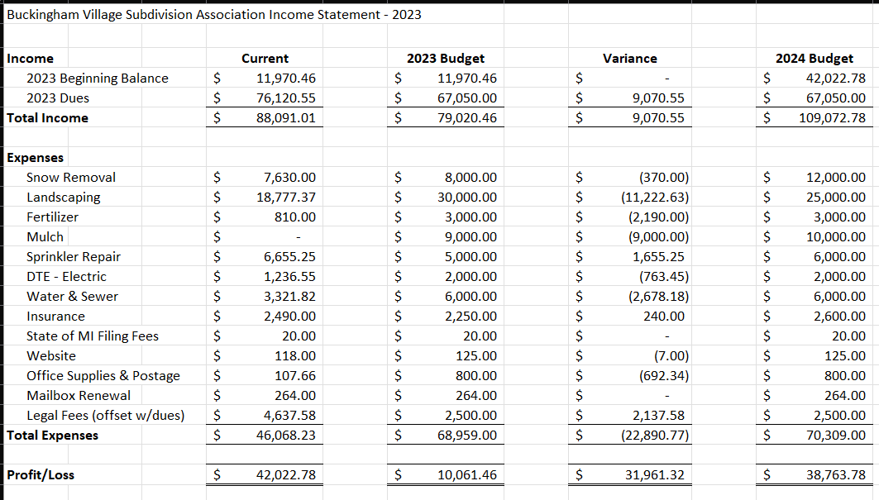
Financials

Slide 10
Dues/Late Fees
Methods of payment accepted: Venmo, ChasePay, Check
Dues will remain at $225 this year given all the large projects/updates
Dues letters will be mailed out by 1/31/2024 and will also be available on the website
Due by 4/1/2024, then subject to a $20/month late fee
If payment is not received by 7/1/2024, a warning letter will be sent
If payment is still not received by 8/1/2024, account will be forwarded to an attorney for further action

Slide 11
Questions & Comments

