Slide 1
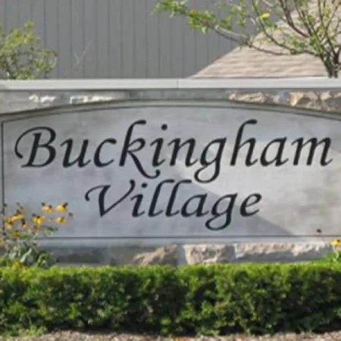
Buckingham Village News
BuckinghamVillageAssociation.com • bvsahoa@gmail.com
Improvement Updates:
Landscaping completed along SE berm on Heydenreich, weed control completed, diseased trees sprayed, dead trees removed.
Sprinkler Repairs – additional heads replaced, relocated where needed.
23 Mile Entrance:
Electrical and sprinkler lines that were damaged during construction will be replaced in the spring
Township contractor will be reimbursing HOA for cost of repairs.
Depending on budget, the landscape at both signs will be cleaned up to match the other two signs and trees/shrubs next to the signs will be cleaned up.
Information/Update
The asphalt sidewalks along Heydenreich are severely damaged after years of neglect and snowplow damage. There is a section currently fenced in by the township that must be replaced as soon as possible as it poses a safety hazard. If we do not replace it, the township will come in and have someone complete the repairs resulting in double the cost for the HOA. The township has agreed to the use of concrete instead of asphalt as it is more cost effective and does not require the maintenance that asphalt would require. The quotes we have received so far from three different cement contractors' range from
$50k - $100k depending on if we replace just the severely damaged section or the full length of sidewalk on both sides of Heydenreich. Since we cannot properly determine the full cost of this project without additional research, we will not be increasing dues at this point. However, there could be a mid-year special dues assessment of $25-$50 per household. Please keep a look out on our website or in the mail for more information this spring.
REMINDERS: Please make sure your driveway and sidewalks are clear of snow and ice, trees and shrubs around walkways are trimmed so they're not impeding the sidewalks, cars are not parked blocking sidewalks, that you are picking up after your animals, and respecting others property. Also remember to fill out an Architectural Request Form found on our website and email it to the HOA anytime you are making changes to the outside or your home. We hope everyone has a great year ahead!
Be sure to check our website and subscribe to be notified when updates are posted!
IMPORTANT: Please note that the HOA and Pool Association are two separate boards with two separate dues assessments each year.

