Slide 1

Buckingham Village HOMEOWNERS’ Association
2022 Annual Meeting

Slide 2
Mission Statement
“To maintain the beauty and services of our community with integrity and transparency.”

Slide 3
General Meeting Conduct
We would appreciate for everyone to adhere to one conversation and allow the other party to finish speaking. We also ask that you be respectful and keep the conversation constructive.

Slide 4
Board Members
President – Renay DeLuca
Treasurer – Rachel Rost
Secretary – Karen Kruszka
General Member – Michelle Folden
General Member – Michelle Efthemiou

Slide 5
Agenda
Financials
Dues/Late Fees
  New methods of paying
Architectural Change Request Form (available on website)
Improvement Updates
Good Neighbor Courtesy (BE A GOOD NEIGHBOR!!)
Board Member Elections

Slide 6
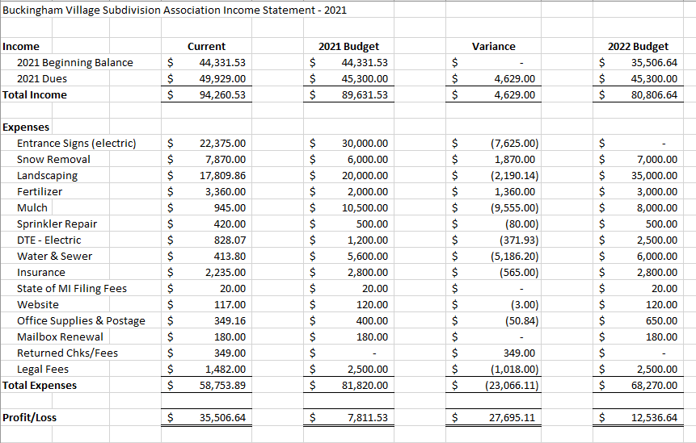
Financials

Slide 7
Dues/Late Fees
New methods of payment now accepted: Venmo, ChasePay
Dues will stay the same as last year: $150.00
Dues letters will be mailed out by 1/31/2022 and will also be available on the website
Due by 4/1/2022, then subject to a $20/month late fee
If payment is not received by 7/1/2022, a warning letter will be sent
If payment is still not received by 8/1/2022, account will be forwarded to an attorney

Slide 8
Website
Buckinghamvillageassociation.com
Subscribe to be notified of updates
Important HOA information, financials, ECR’s, other notifications

Slide 9
Improvement Updates
New landscape company
  Flower bed improvements (Spring/Summer 2022)
  Tree trimming and new trees along Heidenreich
Sign/Electrical update
    New signs at 23 and Bredenbury
    Electrical at all signs
Christmas lights!

Slide 10
Sub Garage Sale
Will be held this June 23 (Thursday), 24 (Friday) and 25 (Saturday)

Slide 11
Architectural Change Request Form
The Architectural Change Request Form is available on the website
  Some paper copies are also available on the sign in table
Please fill out and submit to the HOA when changing the outward appearance of your home
Architectural change guidelines are available on the website as well
Will be voted on within 1 month of submission

Slide 12
Be A Good Neighbor!
(Common courtesy for the neighborhood)
Not blocking sidewalks with vehicles or trailers
Maintaining lawn and landscaping including any trees or shrubs that are blocking the sidewalks
Shoveling sidewalks and driveways in the winter
Cleaning up after your dog on walks
Not littering
Respecting other peoples’ property

Slide 13
Board Member Elections
General Member (2 positions) – 1 year term

Slide 14
Questions & Comments

