Slide 1

Buckingham Village Subdivision Association
2018 Annual Meeting

Slide 2
Mission Statement
“To maintain the beauty and services of our community with integrity and transparency.”

Slide 3
General Meeting Conduct
We would appreciate for everyone to adhere to one conversation and allow the other party to finish speaking. We also ask that you be respectful and keep the conversation constructive.

Slide 4
Board Members
President – Kristy Ownby
Treasurer – Rachel Rost
Secretary – Jessica Edwards
General Member – Helen Poniatowski
General Member – Karen Kruszka

Slide 5
Agenda
Financials
Dues/Late Fees
Website
Improvement Updates
Board Member Elections

Slide 6
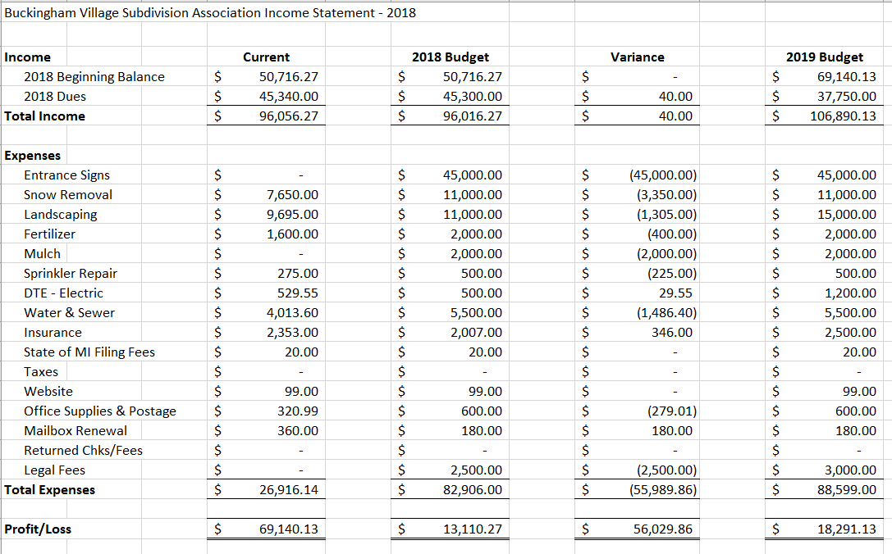
Financials

Slide 7
Dues/Late Fees
Dues invoices will be mailed out next week and are due by April 1st
Dues will decrease to $125.00 annually
From April 2nd to May 1st the payment due with late fee will increase to $175.00
From May 2nd to June 1st the payment due with late fees will increase to $225.00

Slide 8
Website
Buckinghamvillageassociation.com
Subscribe to be notified of updates
Important HOA information, financials, ECR’s, other notifications

Slide 9
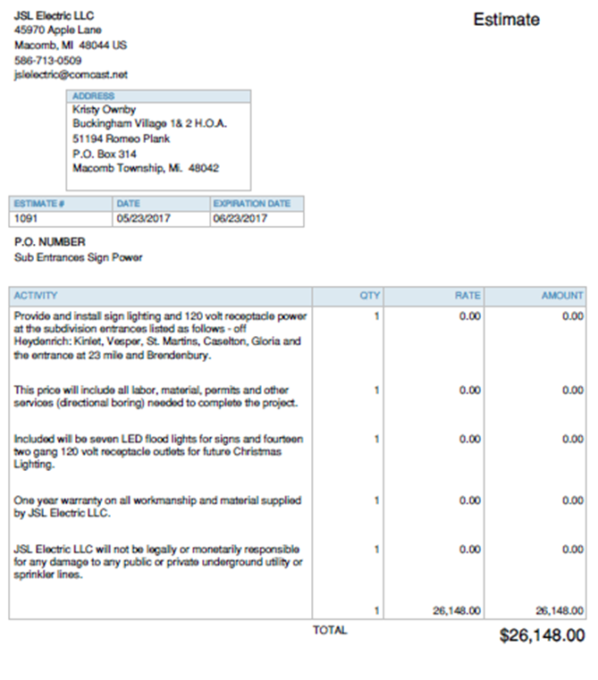
Improvement Updates
New landscape company
  Flower bed improvements
  Tree trimming
  Mulch
Sign/Electrical update

Slide 10
Board Member Elections
President, Treasurer, Secretary – 2 year term
General Member (2 positions) – 1 year term

Slide 11
Questions & Comments

