Slide 1

Buckingham Village HOMEOWNERS’ Association
2023 Annual Meeting

Slide 2
Mission Statement
“To maintain the beauty and services of our community with integrity and transparency.”

Slide 3
General Meeting Conduct
We would appreciate for everyone to adhere to one conversation and allow the other party to finish speaking. We also ask that you be respectful and keep the conversation constructive.

Slide 4
Board Members
President – Renay DeLuca
Treasurer – Rachel Rost
Secretary – Karen Kruszka
General Member – Michelle Folden
General Member – Michelle Efthemiou

Slide 5
Agenda
Improvement Updates
Future Projects
General Information
Financials
Dues
Board Member Elections
Questions/Comments

Slide 6
Improvement Updates
Landscaping complete along Heydenreich & in front of signs
Sprinkler Repairs
  Many lines/heads repaired, new control boxes
Dues Collections/Legal Actions
  From 12 unpaying households to 2

Slide 7
Future Projects
Additional landscaping updates on SE corner of Heydenriech & Vesper
  Overhaul of landscaping along areas on 23 mile once construction is complete
    Repairs to sprinkler and electrical lines will be needed as well - unsure at this point if county will cover
Treatment of crab apple trees that have scale disease along Heydenreich
Additional repairs to sprinkler lines as maintenance hasn’t been done regularly
  Multiple heads need to be replaced
  Some lines/heads need to be relocated
Sidewalk repairs to asphalt on both sides of Heydenreich

Slide 8

General Information
Standard Mailboxes
  If your current mailbox needs to be replaced, you must replace it with the standard mailbox for our sub
  A link and further details can be found on our website in the ‘INFO’ section
Household Improvements
  Any improvements to the outside of your home need to be approved by the board
  An Architectural Request Form must be filled out (in the INFO section of our website)
  and submitted to the HOA email with the necessary documents prior to beginning the work
Annual Sub Sale
  June 22-24th (Thursday-Saturday)

Slide 9
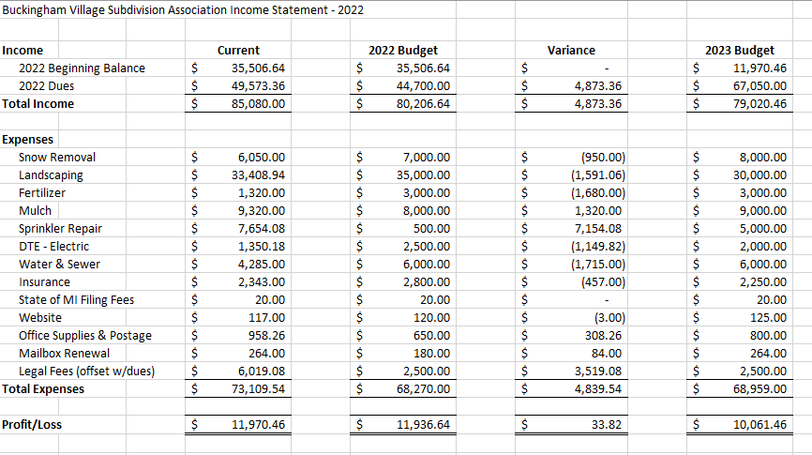
Financials

Slide 10
Dues/Late Fees
Methods of payment accepted: Venmo, ChasePay, Check
Dues will be increased to $225 this year given all the large projects/updates
Dues letters will be mailed out by 1/31/2023 and will also be available on the website
Due by 4/1/2023, then subject to a $20/month late fee
If payment is not received by 7/1/2023, a warning letter will be sent
If payment is still not received by 8/1/2023, account will be forwarded to an attorney for further action

Slide 11
Board Member Elections
President – 2-year term
    Oversee and organize projects
    Schedule annual meetings and others as needed
    Manage overall communication of the board, answer emails
Secretary – 2-year term
    Create agendas and keep minutes for all meetings
    Maintain website and post updates/notices
    Prepare and mail annual dues and other notices
Treasurer – 2-year term
    Prepare and maintain financial statements and budgets
    Collect annual dues and maintain bank account
General Member (2 positions) – 1 year term
    Attend meetings, vote on board matters
    Assist where needed

Slide 12
Questions & Comments

