Slide 1

Buckingham Village Subdivision Association
2017 Annual Meeting

Slide 2
Mission Statement
“To maintain the beauty and services of our community with integrity and transparency.”

Slide 3
General Meeting Conduct
We would appreciate for everyone to adhere to one conversation and allow the other party to finish speaking. We also ask that you be respectful and keep the conversation constructive.

Slide 4
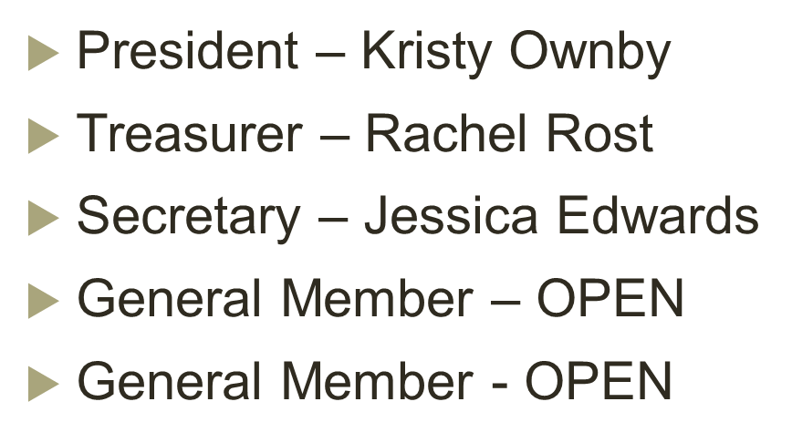
Board Members

Slide 5
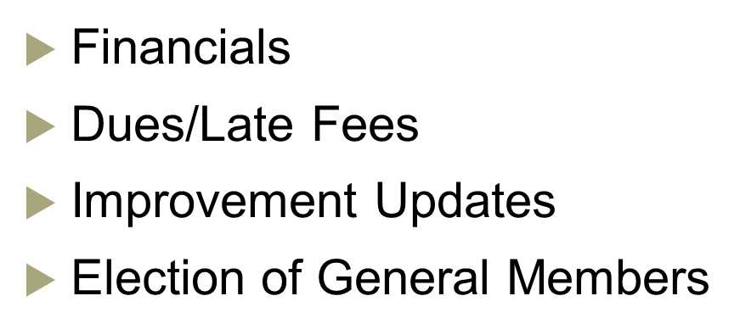
Agenda

Slide 6
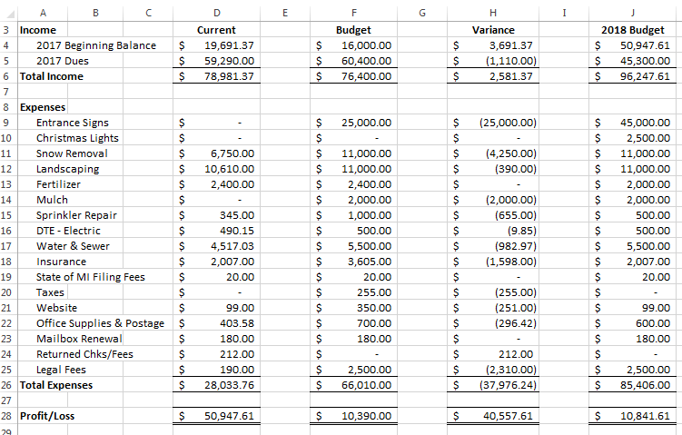
Financials

Slide 7
Dues/Late Fees
Dues invoices will be mailed out next week and are due by March 1st
Dues will decrease back to $150.00 annually
From March 2nd to April 1st the payment due with late fee will increase to $200.00
From April 2nd to May 1st the payment due with late fees will increase to $250.00

Slide 8
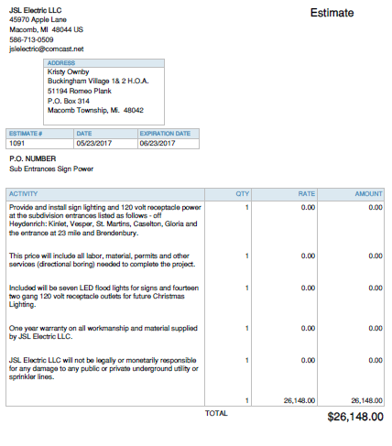
Improvement Updates
Electrical estimate
Construction will begin in Spring 2018

Slide 9
General Member Election
1 year term
Assist with HOA duties
Attend 3 meetings per year
Must be willing to actively participate throughout the term

Slide 10
Questions & Comments

