Slide 1
Annual Fall Meeting 2016
Buckingham Village Subdivision Association

Slide 2


Conduct
We would appreciate for everyone to adhere to one conversation and allow the other party to finish speaking. We also ask that you be respectful and keep the conversation constructive.
conversation and allow the other party to finish speaking. We also ask that you be respectful and keep the conversation constructive.

Slide 3
Board of Directors
President - John Schmitz (Resigned)
Vice President - Kristy Ownby
Treasurer - Andrew Micallef
Secretary - Kelly Masters
Director - Jan Simonsen
The above board took office on January 1st, 2015 and served a two year term.spectful and keep the conversation constructive.

Slide 4
Mission Statement
.
“To maintain the beauty and services of our community with integrity and transparency.”

Slide 5
Agenda
Profit & Loss
Dues/Late Fees
Budget
Election

Slide 6
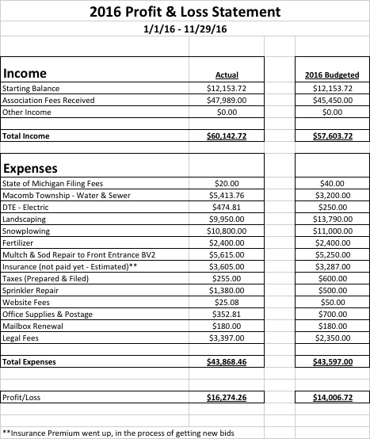

Slide 7
Dues & Late Fees
Dues invoices will be mailed out the first full week of December and are due by March 1st.
Dues will increase to $200.00 annually to cover the cost of enhancements to the common areas.
From March 2nd to April 1st the payment due with late fee will increase to $225.00.
From April 2nd to May 1st the payment due with late fees will increase to $250.00.

Slide 8
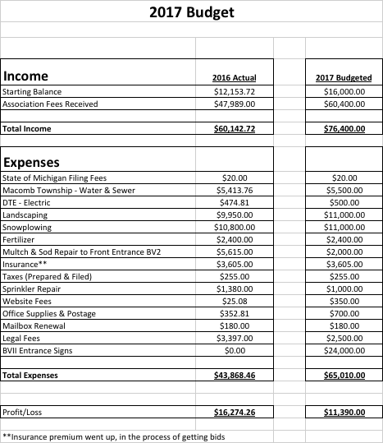

Slide 9
Candidates for Election
Kristy Ownby (Vice President)
Kelly Masters (Secretary)
Jan Simonsen (Director)
Rachel Rost
Jessica Edwards
Jeff Brender
Positions will be appointed by the board after the election.
President, Secretary & Treasurer positions will serve 2 year terms.
The two Director positions will serve 1 year terms.

